Slide 1
Separating Programming and Presentation:
JSP Technology
CSI 3140
WWW Structures, Techniques and Standards

Slide 2
Why JSP?
Servlet/CGI approach: server-side code is a program with HTML embedded
JavaServer Pages (and PHP/ASP/ColdFusion) approach: server-side “code” is a document with program embedded
  Supports cleaner separation of program logic from presentation
  Facilitates division of labor between developers and designers

Slide 3
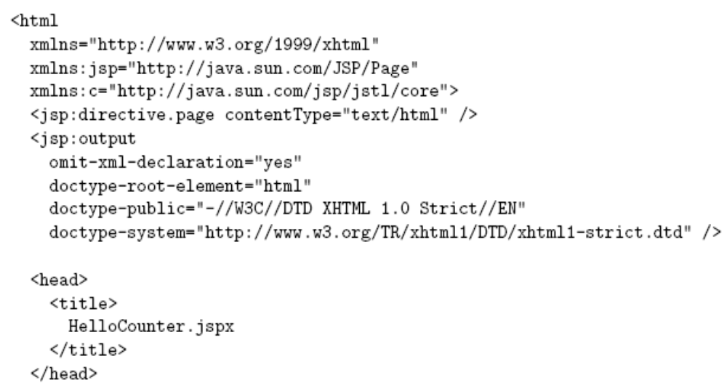
JSP Example
Default namespace is XHTML

Slide 4
JSP Example
Also uses two
JSP-defined
namespaces

Slide 5
JSP Example
JSP-defined
markup (initialization)

Slide 6
JSP Example
Standard XHTML

Slide 7
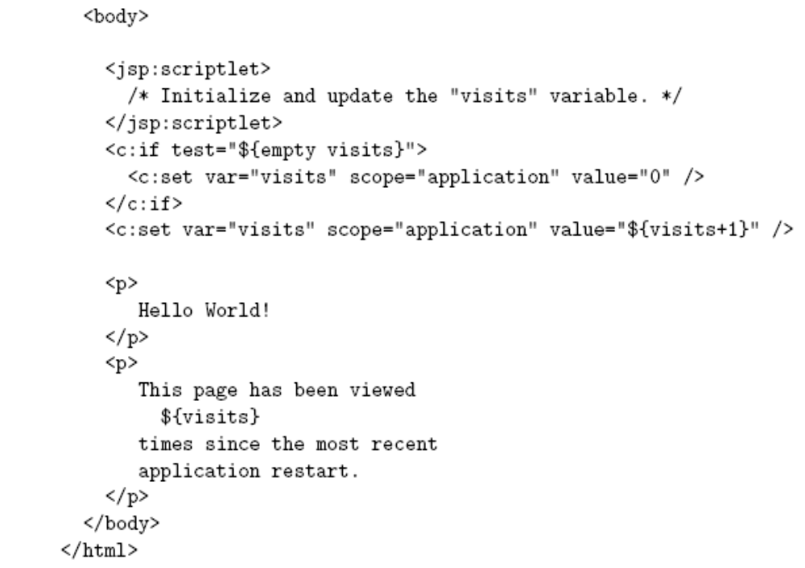
JSP Example
JSP
scriptlet

Slide 8
JSP Example
JSP-based program logic:
initialize and increment variable

Slide 9
JSP Example
Replaced with value of variable

Slide 10
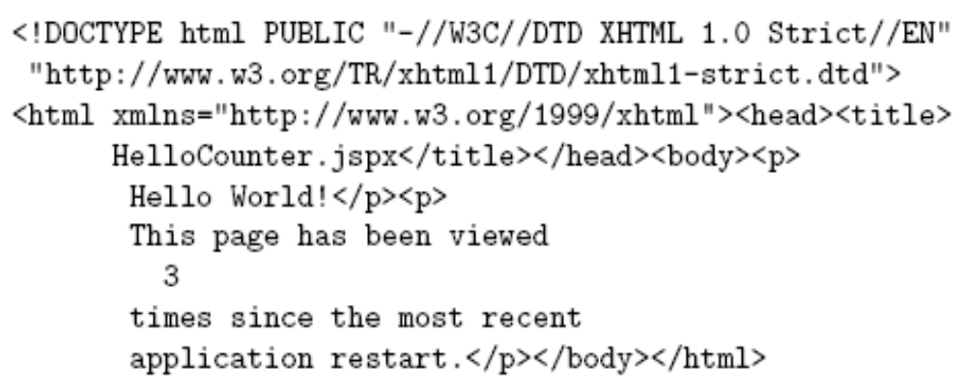
JSP Example
Output
XHTML
document
after 3 visits

Slide 11
JSP Example

Slide 12
JSP Example
Used html as root element
  Can use HTML-generating tools, such as Mozilla Composer, to create the HTML portions of the document
  JSP can generate other XML document types as well

Slide 13
JSP Example

Slide 14
JSP Example
Namespaces
  JSP (basic elements, normal prefix jsp)
  Core JSP Standard Tag Library (JSTL)
  (prefix c)
    Tag library: means of adding functionality beyond basic JSP
    JSTL included in with JWSDP 1.3 version of Tomcat
    JSTL provides tag libraries in addition to core (more later)

Slide 15
JSP Example

Slide 16
JSP Example
JSP elements
  directive.page: typical use to set HTTP response header field, as shown (default is text/xml)
  output: similar to XSLT output element (controls XML and document type declarations)

Slide 17
JSP Example

Slide 18
JSP Example

Slide 19
JSP Example
Template data: Like XSLT, this is the HTML and character data portion of the document
Scriptlet: Java code embedded in document
  While often used in older (non-XML) JSP pages, we will avoid scriptlet use
  One use (shown here) is to add comments that will not be output to the generated page

Slide 20
JSP Example

Slide 21
JSP Example
Core tag library supports simple programming
  if: conditional
    empty: true if variable is non-existent or undefined
  set: assignment
    application scope means that the variable is accessible by other JSP documents, other users (sessions)

Slide 22
JSP and Servlets
JSP documents are not executed directly
  When a JSP document is first visited, Tomcat
    Translates the JSP document to a servlet
    Compiles the servlet
  The servlet is executed
Exceptions provide traceback information for the servlet, not the JSP
  The servlets are stored under Tomcat work directory

Slide 23
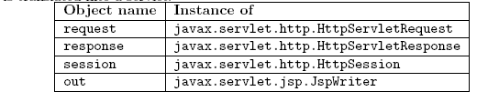
JSP and Servlets
A JSP-generated servlet has a _jspService() method rather than doGet() or doPost()
  This method begins by automatically creating a number of implicit object variables that can be accessed by scriptlets

Slide 24
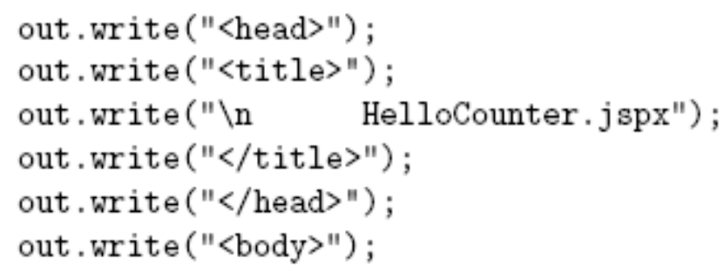
JSP and Servlets
Translating template data:
Scriptlets are copied as-is to servlet:

Slide 25
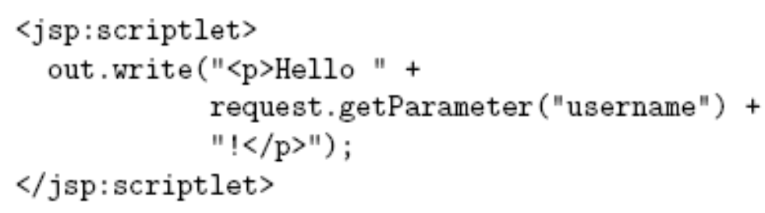
JSP and Servlets
Scriptlets can be written to use the implicit Java objects:
We will avoid this because:
  It defeats the separation purpose of JSP
  We can incorporate Java more cleanly using JavaBeans technology and tag libraries

Slide 26
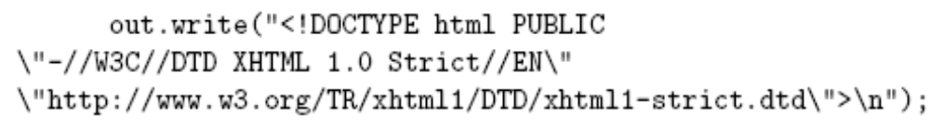
JSP and Servlets
JSP elements translate to:
${visits} in template code translates to out.write() of value of variable
Core tags (e.g., if) normally translate to a method call
JSP default

Slide 27
Web Applications
A web application is a collection of resources that are used together to implement some web-based functionality
Resources include
  Components: servlets (including JSP-generated)
  Other resources: HTML documents, style sheets, JavaScript, images, non-servlet Java classes, etc.

Slide 28
Web Applications
Sharing data between components of a web application
  Tomcat creates one ServletContext object per web application
  Call to getServletContext() method of a servlet returns the associated ServletContext
  ServletContext supports setAttribute()/getAttribute() methods

Slide 29
Web Applications
Within Tomcat, all of the files of a simple web app are placed in a directory under webapps
  JSP documents can go in the directory itself
  “Hidden” files--such as servlet class files--go under a WEB-INF subdirectory (more later)
Once the web app files are all installed, use Tomcat Manager to deploy the app

Slide 30
Web Applications
Deploying a web app consisting of a single JSP document HelloCounter.jspx:
  Create directory webapps/HelloCounter
  Copy JSP doc to this directory
  Visit localhost:8080/manager/html
  Enter HelloCounter in “WAR or Directory URL” box and click Deploy button
Web app is now at URL localhost:8080/HelloCounter/
HelloCounter.jspx

Slide 31
Web Applications
Manager app:
  Stop: web app becomes unavailable (404 returned)
  Start: web app becomes available again
  Reload: stop web app, restart with latest versions of files (no need to restart server)
  Undeploy: stop app and remove all files!
    Always keep a copy of app outside webapps

Slide 32
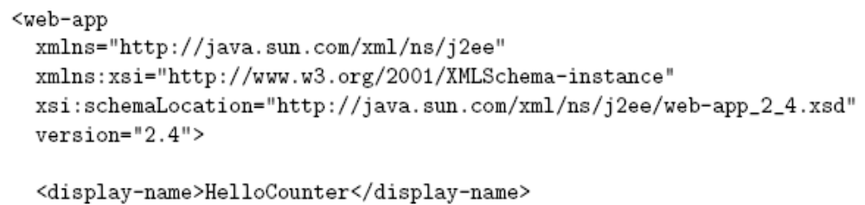

Web Applications
Set parameters of a web application by
  Creating a deployment descriptor (XML file)
  Saving the descriptor as WEB-INF/web.xml
Simple example web.xml:

Slide 33
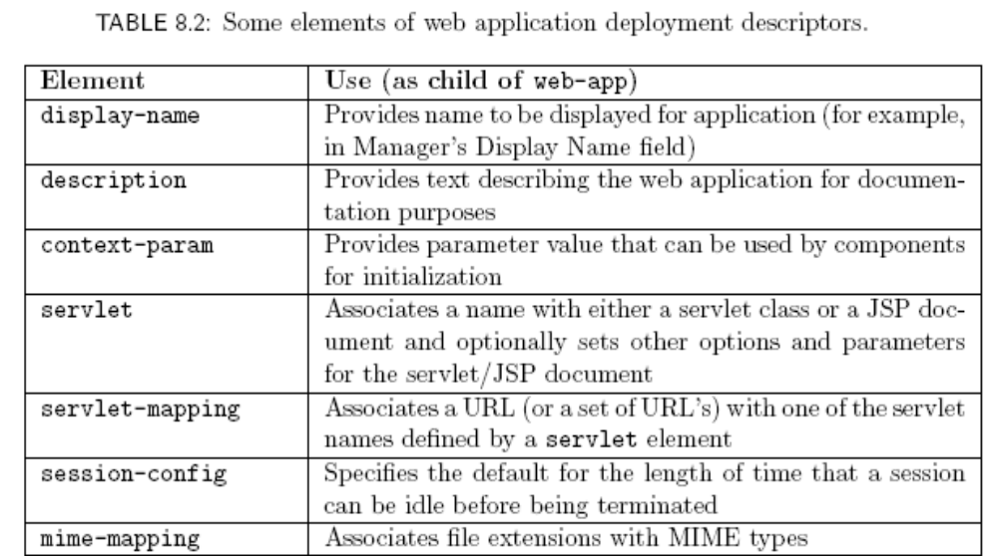
Web Applications

Slide 34
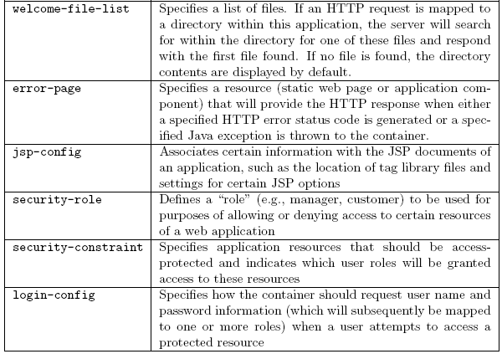
Web Applications

Slide 35
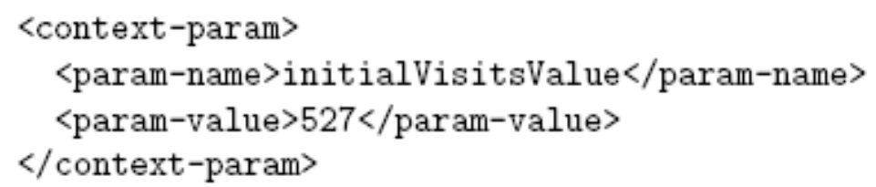
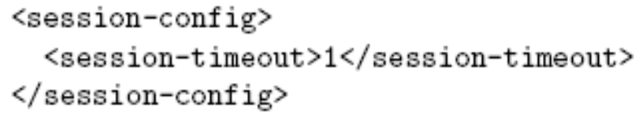
Web Applications
Some examples:
  Setting an initial value accessible by application.getInitParameter():
  Setting the length of time (in minutes) before a session times out:

Slide 36
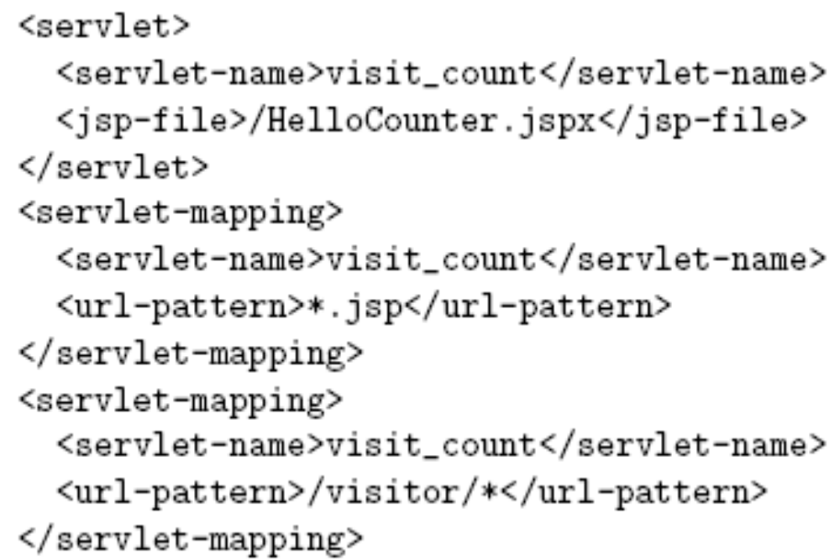
Web Applications
Mapping URLs to app components:

Slide 37
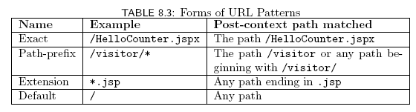
Web Applications
There are four URL patterns (from high to low precedence)
If no URL pattern matches, Tomcat treats path as a relative file name

Slide 38
Web Applications
Methods on request object for obtaining path information:
  Example: /HelloCounter/visitor/test.jsp
  getContextPath(): returns /HelloCounter
  getServletPath(): returns /visitor
  getPathInfo(): returns /test.jsp

Slide 39
JSP Expression Language (EL)
${visits+1} is an example of an EL expression embedded in a JSP document
  ${…} is the syntax used in JSP documents to mark the contained string as an EL expression
  An EL expression can occur
    In template data: evaluates to Java String
    As (part of) the value of certain JSP attributes: evaluates to data type that depends on context

Slide 40
JSP Expression Language (EL)
EL literals:
  true, false
  decimal integer, floating point, scientific-notation numeric literals
  strings (single- or double-quoted)
  null

Slide 41

JSP Expression Language (EL)
EL variable names: like Java
  Can contain letters, digits, _ , and $
  Must not begin with a digit
  Must not be reserved:

Slide 42
JSP Expression Language (EL)
EL operators:
  Relational: <, >, <=, >=, ==, !=
    Or equivalents: lt, gt, le, ge, eq, ne
  Logical: &&, ||, !
    Or equivalents: and, or, not
  Arithmetic:
    +, - (binary and unary), *
    /, % (or div, mod)
  empty: true if arg is null or empty string/array/Map/Collection
  Conditional: ? :
  Array access: [ ] (or object notation)
  Parentheses for grouping

Slide 43
JSP Expression Language (EL)
EL automatic type conversion
  Conversion for + is like other binary arithmetic operators (+ does not string represent concatenation)
  Otherwise similar to JavaScript

Slide 44
JSP Expression Language (EL)
EL provides a number of implicit objects
Most of these objects are related to but not the same as the JSP implicit objects
  JSP implicit objects cannot be accessed directly by name in an EL expression, but can be accessed indirectly as properties of one of the EL implicit objects

Slide 45
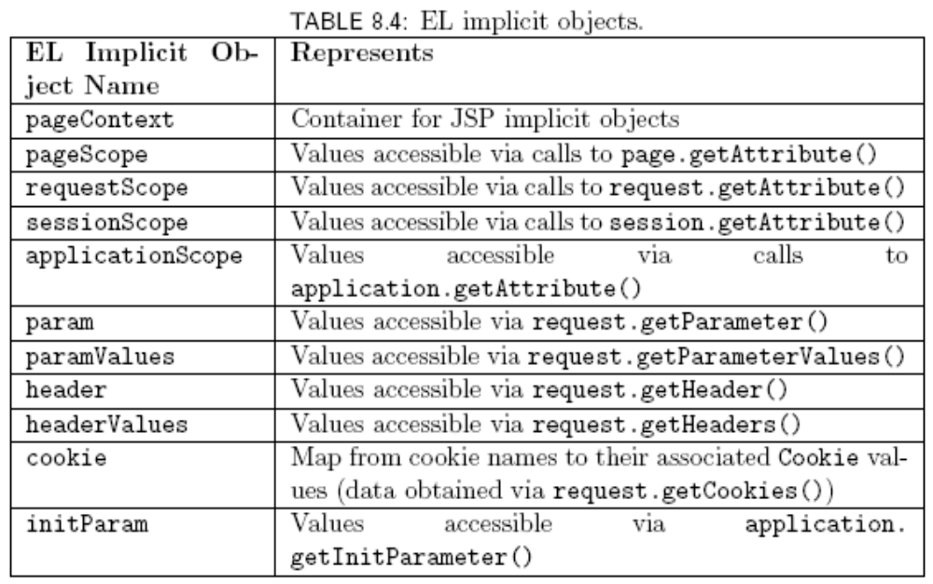
JSP Expression Language (EL)

Slide 46
JSP Expression Language (EL)
pageContext: provides access to JSP implicit objects
  Ex: EL expression pageContext.request is reference to the JSP request object
page: JSP implicit object representing the servlet itself
JSP objects page, request, session, and application all have getAttribute() and setAttribute() methods
  These objects store EL scoped variables (e.g., visits)

Slide 47
JSP Expression Language (EL)
Reference to non-implicit variable is resolved by looking for an EL scoped variable in the order:
  page
  request
  session
  application
If not found, value is null
If found, value is Object
  JSP automatically casts this value as needed

Slide 48
JSP Expression Language (EL)
All EL implicit objects except pageContext implement Java Map interface
In EL, can access Map using array or object notation:
  Servlet: request.getParameter(“p1”)
  EL:
  param[‘p1’]
  or
  param.p1

Slide 49
JSP Expression Language (EL)
Array/List access:
  If EL scoped variable aVar represents
    Java array; or
    java.util.List
  and if EL scoped variable index can be cast to integer
  then can access elements of aVar by
    aVar[index]
    aVar.index

Slide 50
JSP Markup
Three types of markup elements:
  Scripting
    Ex: scriptlet
    Inserts Java code into servlet
  Directive
    Ex: directive.page
    Instructs JSP translator
  Action
    Standard: provided by JSP itself
    Custom: provided by a tag library such as JSTL

Slide 51
JSP Markup
Two JSPX directives
  directive.page; some attributes:
    contentType
    session: false to turn off use of session object
    errorPage: component that will generate response if an exception is thrown
    isErrorPage: true to access EL implicit exception object
  directive.include: import well-formed XML

Slide 52
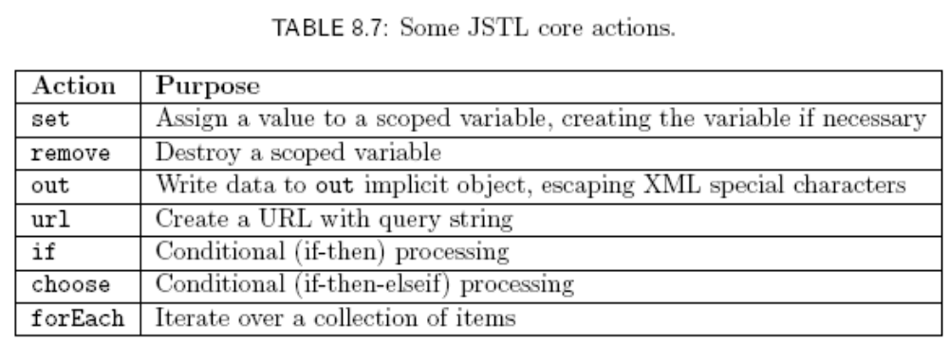
JSP Markup

Slide 53
JSP Markup
Common variables:
  var
    Name of a scoped variable that is assigned to by the action
    Must be a string literal, not an EL expression
  scope
    Specifies scope of scoped variable as one of the literals page, request, session, or application
    page default scope, unless otherwise specified

Slide 54

JSP Markup
set action
  Setting (and creating) a scoped variable
  Setting/creating an element of Map
    Actually, this fails at run time in JWSDP 1.3 (which treats EL implicit object Maps as read-only)
Map
Key

Slide 55
JSP Markup
remove action
  Only attributes are var and scope
  Removes reference to the specified scoped variable from the scope object
  <c:remove var=“visits”
  scope=“application” />

Slide 56
JSP Markup
out action
  Normally used to write a string to the out JSP implicit object
  Automatically escapes all five XML special characters
  If value is null output is empty string
    Override by declaring default attribute

Slide 57
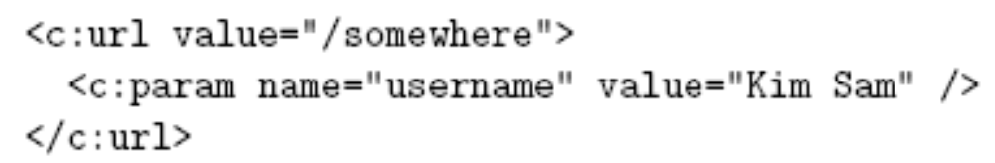
JSP Markup
url action
  value attribute value is a URL to be written to the out JSP implicit object
  URL’s beginning with / are assumed relative to context path
  param elements can be used to define parameters that will be URL encoded

Slide 58
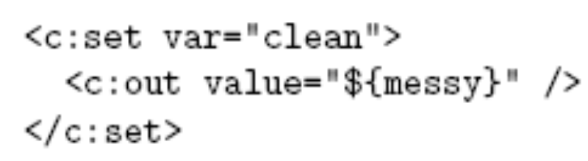
JSP Markup
Alternative to the value attribute (set and param elements)
  If element has content, this is processed to produce a String used for value
  Even out element will produce string, not write to the out object
Assigns value of variable
messy (XML escaped) to
scoped variable clean

Slide 59
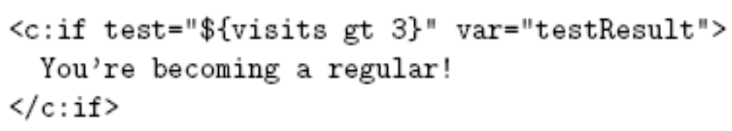
JSP Markup
if action
  General form includes scoped variable to receive test value
    The element can be empty if var is present
Assigned Boolean value
of test attribute

Slide 60
JSP Markup
choose action
<c:choose>
<c:when test=“${visits eq 1}”>
Hi!</c:when>
<c:when test=“${visits eq 2}”>
Welcome back!</c:when>
<c:otherwise>
You’re a regular!</c:otherwise>
</c:choose>

Slide 61
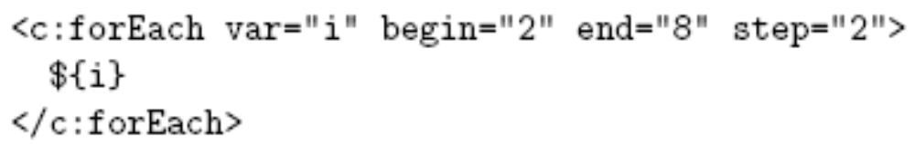
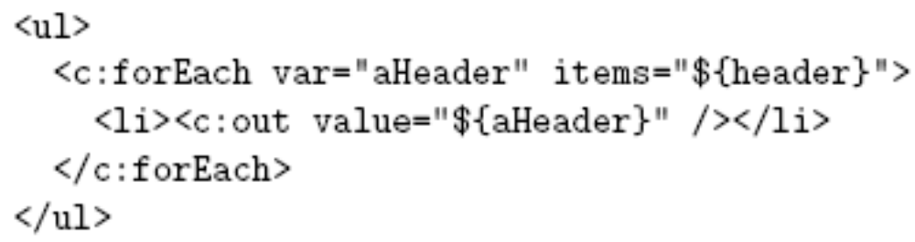
JSP Markup
forEach action
  Used to increment a variable:
  Used to iterate over a data structure:

Slide 62
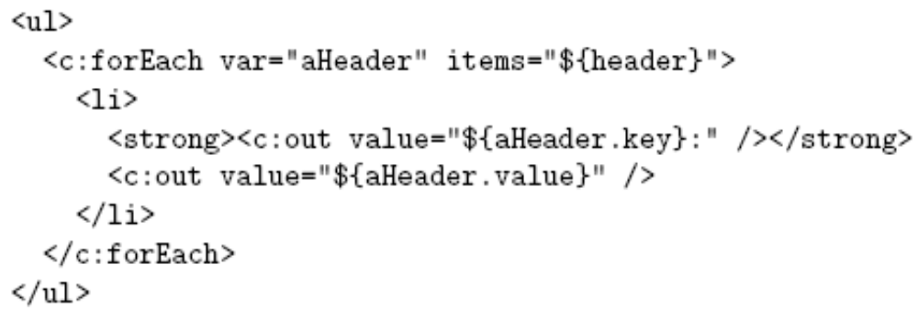
JSP Markup
forEach action
  Can iterate over array, Map, Collection, Iterator, Enumeration
  Elements of Map are Map.Entry, which support key and value EL properties:

Slide 63
JavaBeans Classes
JSTL Core actions are designed to be used for simple, presentation-oriented programming tasks
More sophisticated programming tasks should still be performed with a language such as Java
JavaBeans technology allows a JSP document to call Java methods

Slide 64
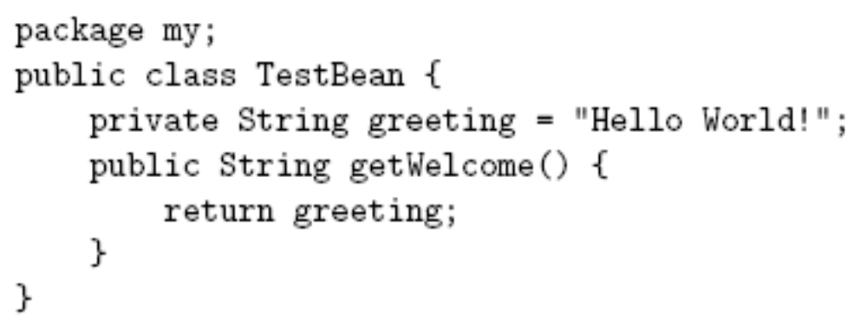
JavaBeans Classes
Example
Requirements: JavaBeans class must
  Be public and not abstract
  Contain at least one simple property design pattern method (defined later)

Slide 65
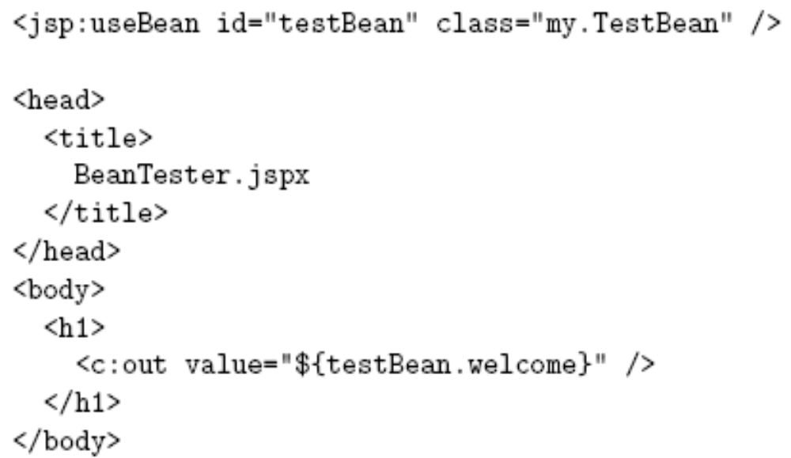
JavaBeans Classes
Using a JavaBeans class in JSP

Slide 66
JavaBeans Classes
Using a JavaBeans class as shown:
  Class must have a default (no-argument) constructor to be instantiated by useBean
    Automatically supplied by Java in this example
  Class should belong to a package (avoids need for an import)
    This class would go in WEB-INF/classes/my/ directory
Instance of a JavaBeans class is a bean

Slide 67
JavaBeans Classes
Simple property design patterns
  Two types: getter and setter
    Both require that the method be public
    getter:
      no arguments
      returns a value
      name begins with get (or is, if return type is boolean) followed by upper case letter
    setter:
      one argument (same type as setter return value)
      void
      name begins with set followed by upper case letter

Slide 68
JavaBeans Classes
EL calls simple property design method in response to access of bean property:
  Attempt to read property generates call to associated get/is method (or error if none exists)
  Attempt to assign value to property generates call to associated set method (or error)

Slide 69
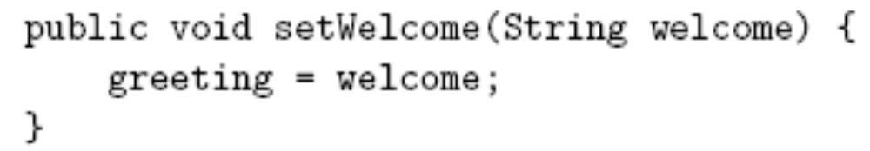
JavaBeans Classes
Example setter method
Calling setter from JSP

Slide 70
JavaBeans Classes
Simple property design pattern methods associate bean properties with beans
  Name of bean property obtained by removing get/is/set method prefix and following the rule:
    If remaining name begins with two or more upper case letters, bean property name is remaining name: setAValue() → AValue
    If remaining name begins with a single upper case letter, bean property name is remaining name with this letter converted to lower case:
    getWelcome() → welcome

Slide 71
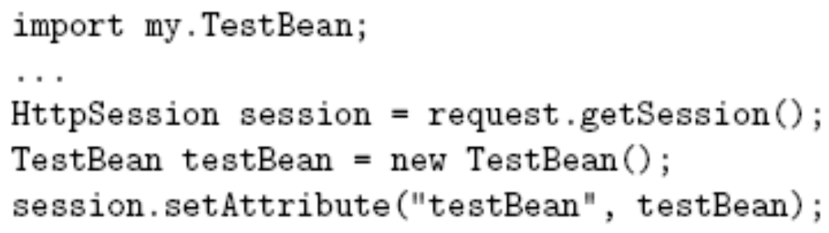
Instantiating Beans
Beans can be instantiated by a servlet and made available to JSP via scope objects
  Servlet
  JSP: no need for useBean action
  ${sessionScope.testBean.welcome}

Slide 72
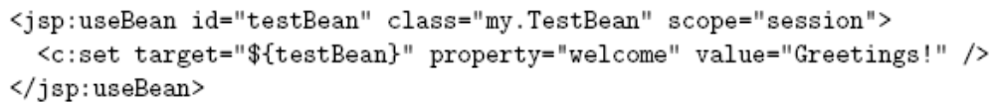
Instantiating Beans
useBean only instantiates a bean if one does not already exist, can optionally perform initialization
Evaluated only if useBean instantiates TestBean

Slide 73
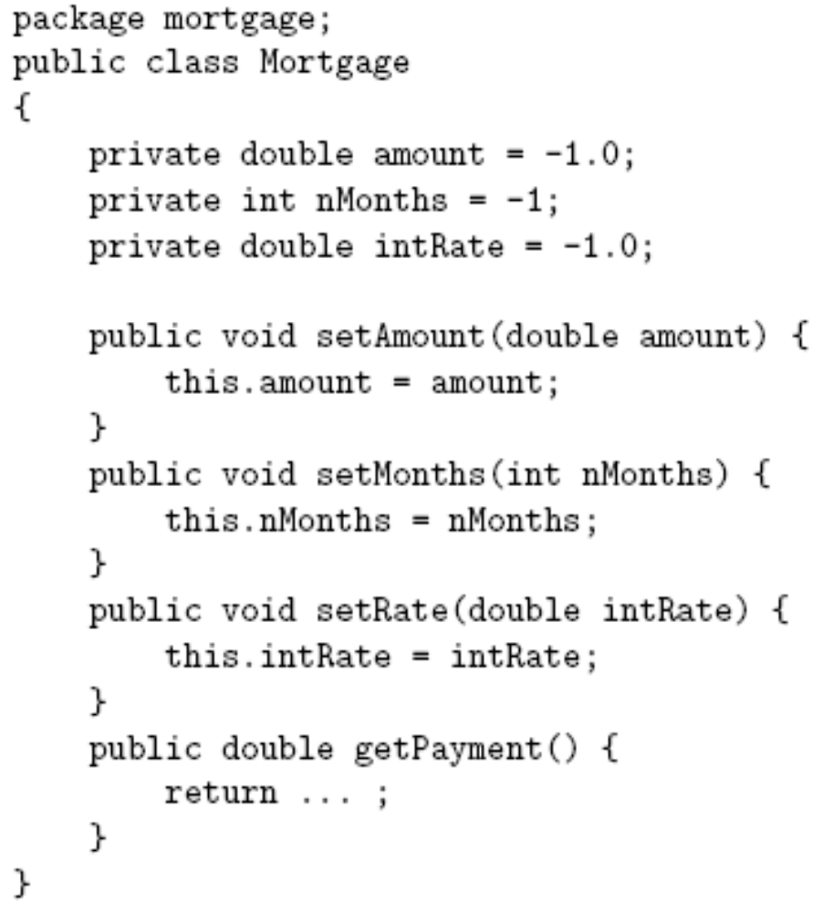
Using Beans
Example:
mortgage
calculation

Slide 74
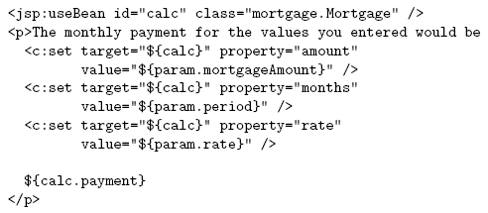
Using Beans
Call to
getPayment()
method

Slide 75
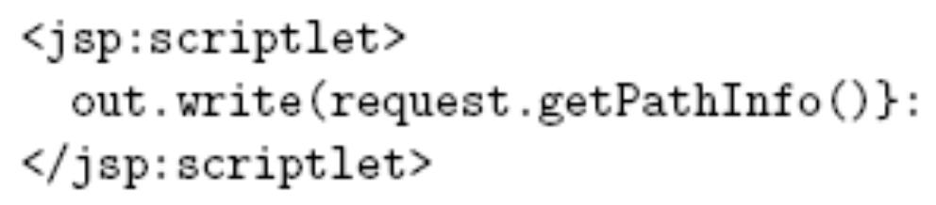
Java API Bean Properties
Many Java API methods conform to simple property design patterns
Can usually treat as bean properties

Slide 76
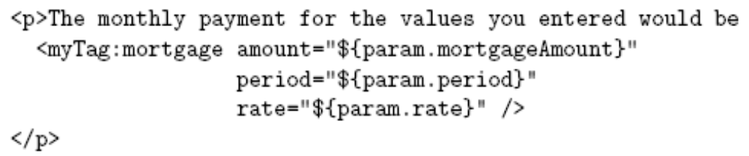
Tag Libraries
Wouldn’t it be nicer to write the mortgage app as

Slide 77
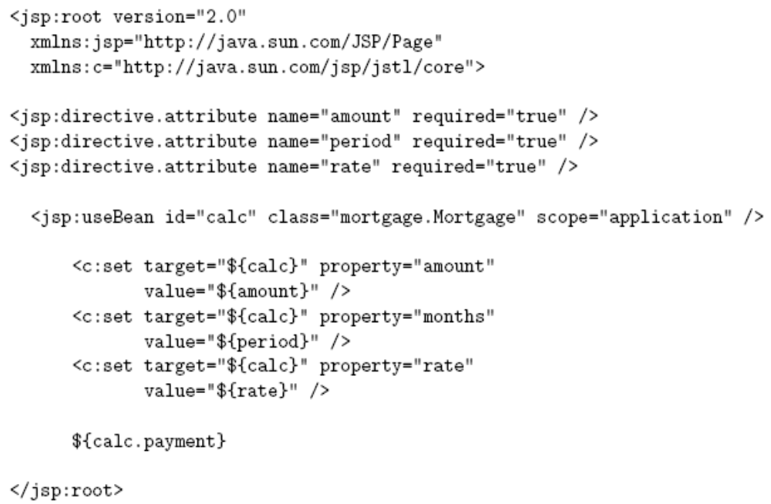
Tag Libraries

Slide 78
Tag Libraries
Place custom tag definition in a tag file having the name of the custom action
  mortgage.tagx
Place tag file in a tag library (e.g., directory containing tag files)
  /WEB-INF/tags
Add namespace declaration for tag library

Slide 79
MVC
Many web apps are based on the Model-View-Controller (MVC) architecture pattern
Model Components
Controller
View
HTTP
request
HTTP
response

Slide 80
MVC
Typical JSP implementation of MVC
Model Components
(beans, DBMS)
Controller
(Java servlet)
View
(JSP document)
HTTP
request
HTTP
response

Slide 81

MVC
Forwarding an HTTP request from a servlet to another component:
  By URL
  By name
Ex: /HelloCounter.jspx

Slide 82
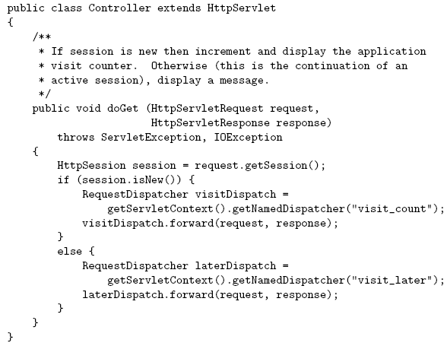
MVC

Slide 83



MVC
How does the controller know which component to forward to?
  getPathInfo() value of URL’s can be used
  Example:
    servlet mapping pattern in web.xml:
    URL ends with:
    getPathInfo() returns:

Slide 84
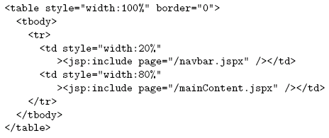
MVC
JSP include action
Execute specified
component and
include its output
in place of the
include element

Slide 85
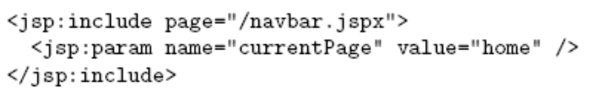
MVC
Adding parameters to the request object seen by an included component:
request object seen by navbar.jspx will include
parameter named currentPage with value home

